Slide 1
The attacks of September 11, 2001

Slide 2
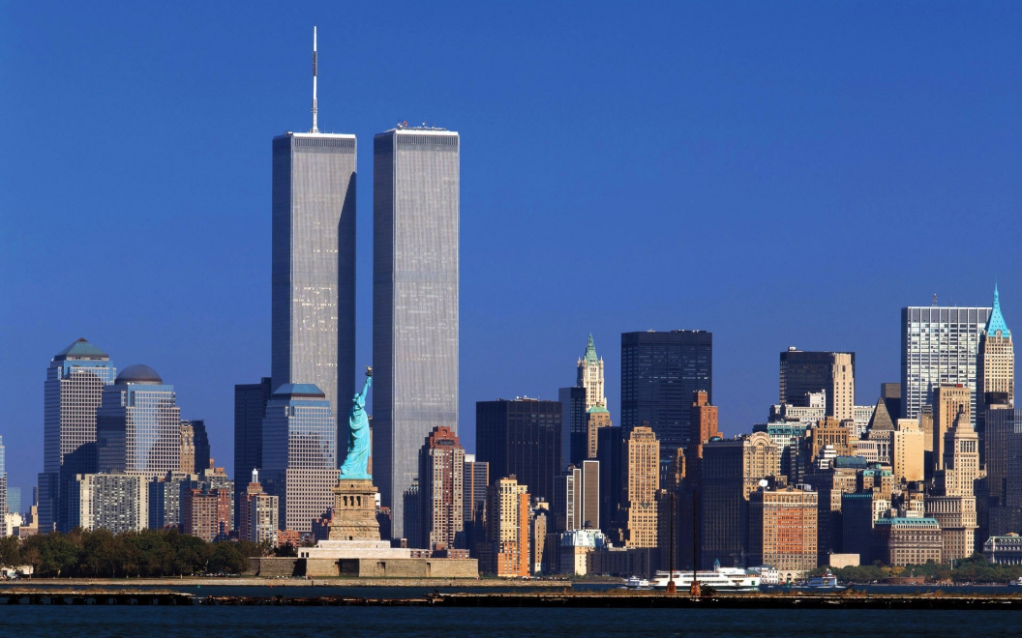
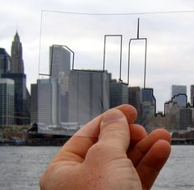
What was America like before 9/11?
9/11 is a common abbreviation for September 11, 2001.
Before 9/11:
Many Americans were familiar with Al-Qaeda, but not Islam.
The Department of Homeland Security did not exist.
The FBI, CIA, and other Federal intelligence agencies had difficulty communicating.

Slide 3
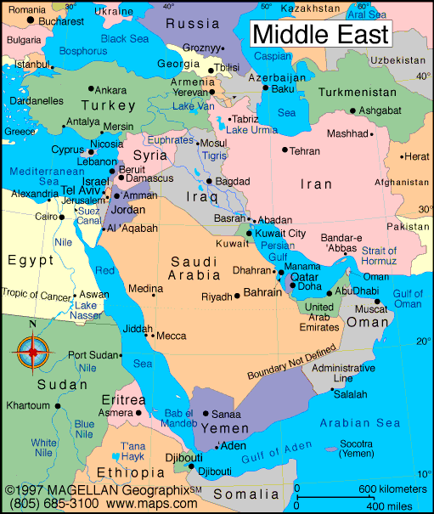
What is Al-Qaeda?
Al-Qaeda is a terrorist network based in the Middle East.
Al-Qaeda seeks to create their ideal “Islamic world” through the use of violence.
It was founded by Osama Bin Ladin.

Slide 4
What is Islam?
Islam is a religion based on the teachings of Mohammed. It is the second most common religion in the world.
Islam advocates gifts to the needy, faith in one God, and doing good works.
People who follow Islam are called Muslims.
Nearly 25% of Earth’s inhabitants are Muslim ( compared to 33% Christian)
Most Muslims don’t support the mission of Al-Qaeda and other terrorist groups.

Slide 5
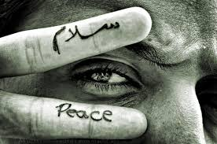
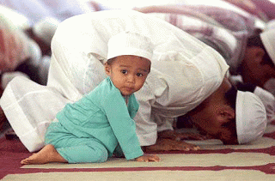
One Important Point!
Although the people responsible for 9/11 were Muslims, this does not mean ALL Muslims are terrorists.
It is important to remember that the majority of the world’s Muslims are good, honest, decent people who…
Do NOT advocate violence
DISAGREE with Al-Qaeda
Do NOT want Al-Qaeda’s “Ideal Islamic State”
Believe that Al-Qaeda DOES NOT represent true Islam

Slide 6
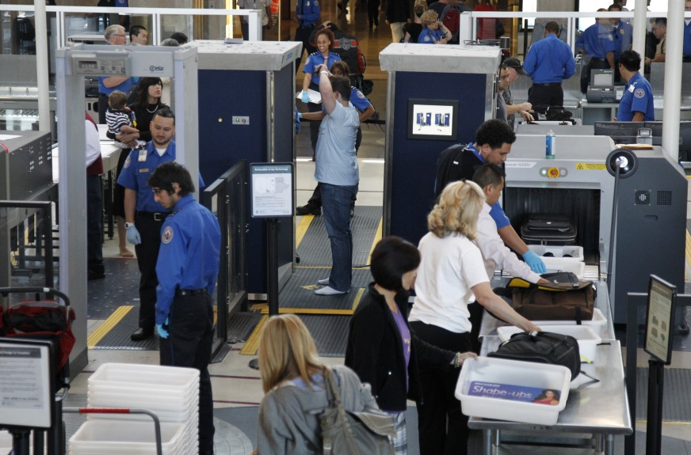
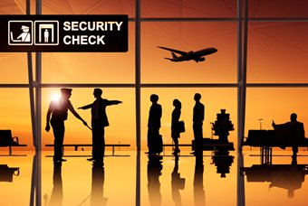
Airports Before September 11th, 2001
If you have flown recently, you know that :
Everyone must walk through a metal detector
All luggage is screened and possibly searched
You can not carry certain items, such as pocketknives and certain liquids
Everyone must present forms of identification and that no one is allowed on the plane without security clearance
Prior to 9/11, many of these measures were not in place

Slide 7
Airplanes Hijacked
On the morning of September 11th, 2001, four airplanes were hijacked by Al-Qaeda terrorists.
Hijack: illegally seize a plane or vehicle and force it to go to a different destination or use it for one's own purposes.
19 terrorists in total worked together.

Slide 8
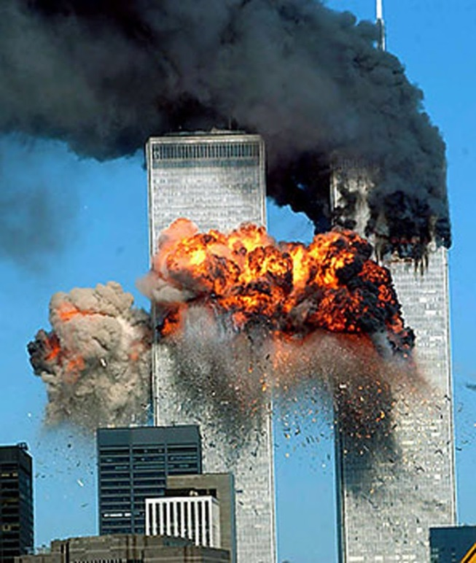
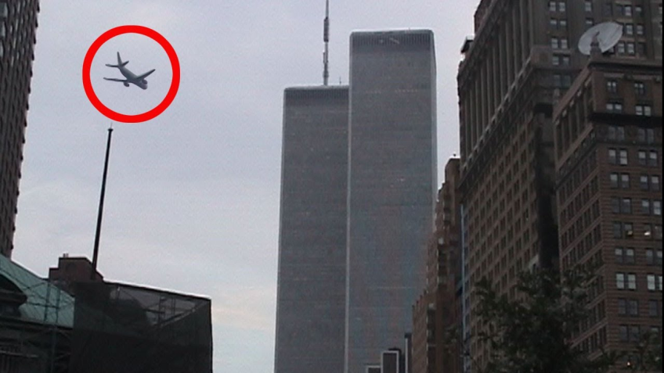
The World Trade Center
8:46am – The first plane crashed into the North Tower of the World Trade Center.
At first, many people thought it was a horrible accident.
9:03am – The second plane crashed into the South Tower of the World Trade Center.
Now there was no doubt – we were under attack!
A 9/11 Timeline

Slide 9
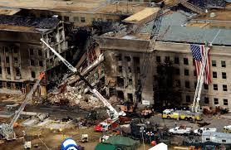
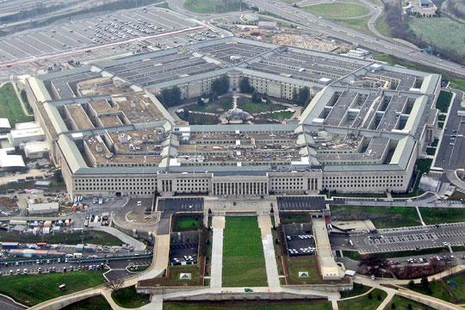
The Pentagon
The third plane crashed into the Pentagon at 9:37am.

Slide 10
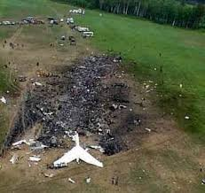
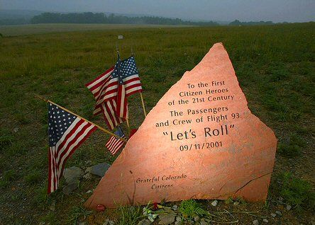
The Fourth Plane
The passengers on board the 4th hijacked plane fought back, overpowering the terrorists.
The plane crash-landed in a field near Shanksville, PA at 10:03am.
Nobody knows for sure where the 4th plane was heading, but it is believed the terrorists were targeting the White House or the Capitol building.

Slide 11
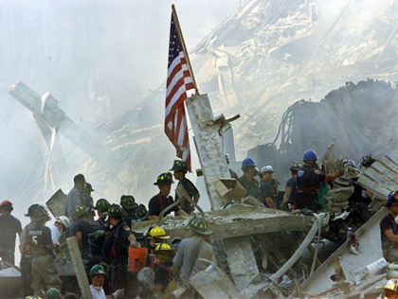
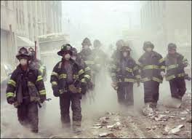
Immediate Reactions
At 9:45am, the FAA ( Federal Aviation Administration) ordered all flights grounded in the United States.
All civilian international flights were redirected or told to turn back.
Police and firefighters rushed to aid the injured.
We Remember: First Hand Interviews of 9/11 Twin Tower Collapse

Slide 12
More Reactions
Many schools, offices, and buildings closed due to security concerns or to show respect.
Airport security was tightened
The War on Terror was launched on September 20th by then President George W. Bush
Many people were afraid and upset
Relief fund and blood donations soared
President Bush Official Statement 9/11

Slide 13
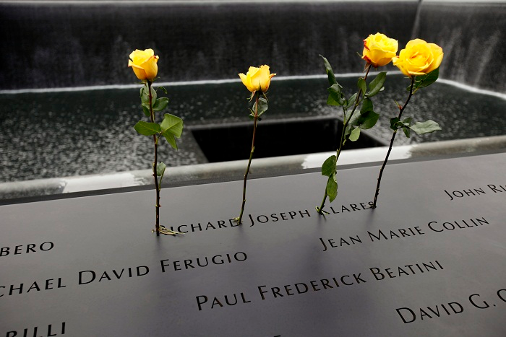
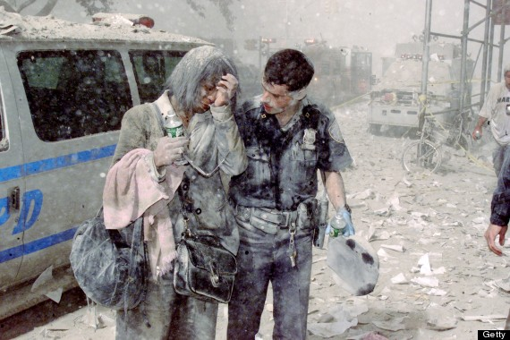
Casualties
Approximately 2,996 people died.
246 on the four planes
2,606 inside and around the World Trade Center
125 inside the Pentagon

Slide 14
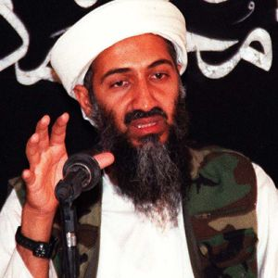
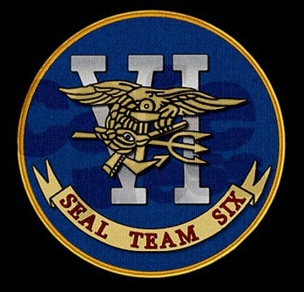
Bin Ladin’s Death
Osama Bin Ladin evaded capture for a long time, even though finding him was considered a priority.
Several high-ranking Al-Qaeda members were captured or killed following 9/11 attacks
Bin Ladin was finally found and killed May 2, 2011.

Slide 15
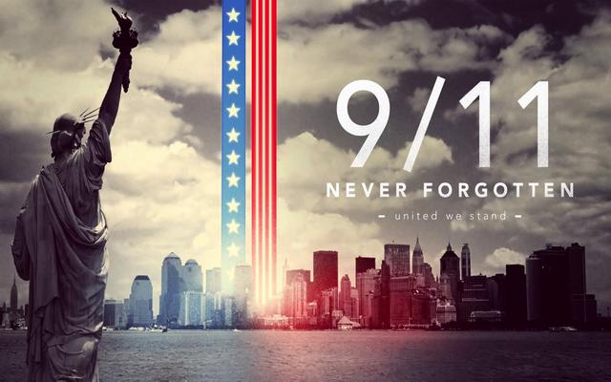
Lessons Learned
There is now better communication among the FBI, CIA, and other authorities.
We now have tighter airport security.
We are more vigilant of threats against the US.
We will never forget: A 9/11 Tribute

Slide 16
Day of Service and Remembrance
What are some ways we can honor and remember those that lost their lives on 9/11?
What can you do this week to serve others in honor of the lives lost on 9/11?
The Ultimate Sacrifice

